Slide 1

Crop Cultivation Guidance System for Farmers
By:
RANITHA N
ECE A
Notes:
Line spacing + Page numbers

Slide 2

INTRODUCTION
Agriculture plays a vital role in our economy, but many farmers lack proper technical guidance.
So, we are developing an online platform that helps farmers select suitable crops based on land, budget, season, and irrigation methods.
The system is developed using Java Swing for the frontend.
MySQL as the backend database to store farmer details and recommendations.
This system provides simple recommendations to support better farming decisions.

Slide 3

PROBLEM STATEMENT
Many farmers, especially beginners, do not have access to proper crop planning guidance.
Selecting the right crop based on land, season, irrigation, and budget is often done by trial and error.
Lack of technical support leads to low productivity and financial loss.
There is a need for a simple digital system to guide farmers in making informed cultivation decisions.

Slide 4

To design and develop a simple database-driven application that assists farmers in selecting suitable and profitable crops using Java and MySQL. 1. Build a farmer-friendly crop advisory system using Java Swing. 2.Implement secure farmer registration and login using JDBC and SQL queries. 3.Provide crop recommendations based on land, budget, season, and irrigation method. 4.Display investment, profit estimation, and irrigation guidance for selected crops. 5.Gain practical experience in integrating Java applications with a MySQL database.
OBJECTIVE

Slide 5
TECHNOLOGY USED
FRONTEND
Java swing is used for the frontend of the application.
It provides a graphical user interface (GUI) for farmers.
Screens include Registration, Login, Crop Advisory Form, and Result Page.
Swing components like JFrame, JLabel, JTextField, JButton, and JComboBox are used.
Helps create a simple and user-friendly interface for beginners.

Slide 6
TECHNOLOGY USED
BACKEND
MySQL is used as the backend database.
It stores farmer registration and login details securely.
Database helps manage user data efficiently.
Ensures data persistence even after the application is closed.
Makes the system reliable and structured.

Slide 7
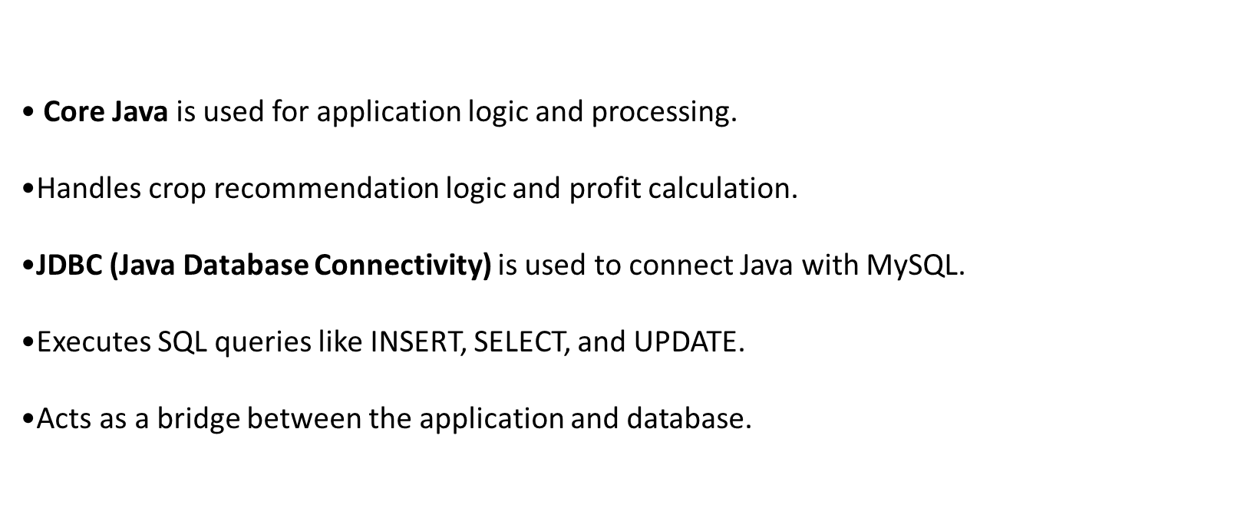
Programming & Connectivity

Slide 8
Eclipse IDE is used for coding, debugging, and running the project.
MySQL Workbench is used to create and manage database tables.
The system follows a simple layered architecture.
Separates user interface, logic, and database handling.
Improves maintainability and understanding of the project.
Development Tools & Architecture

Slide 9
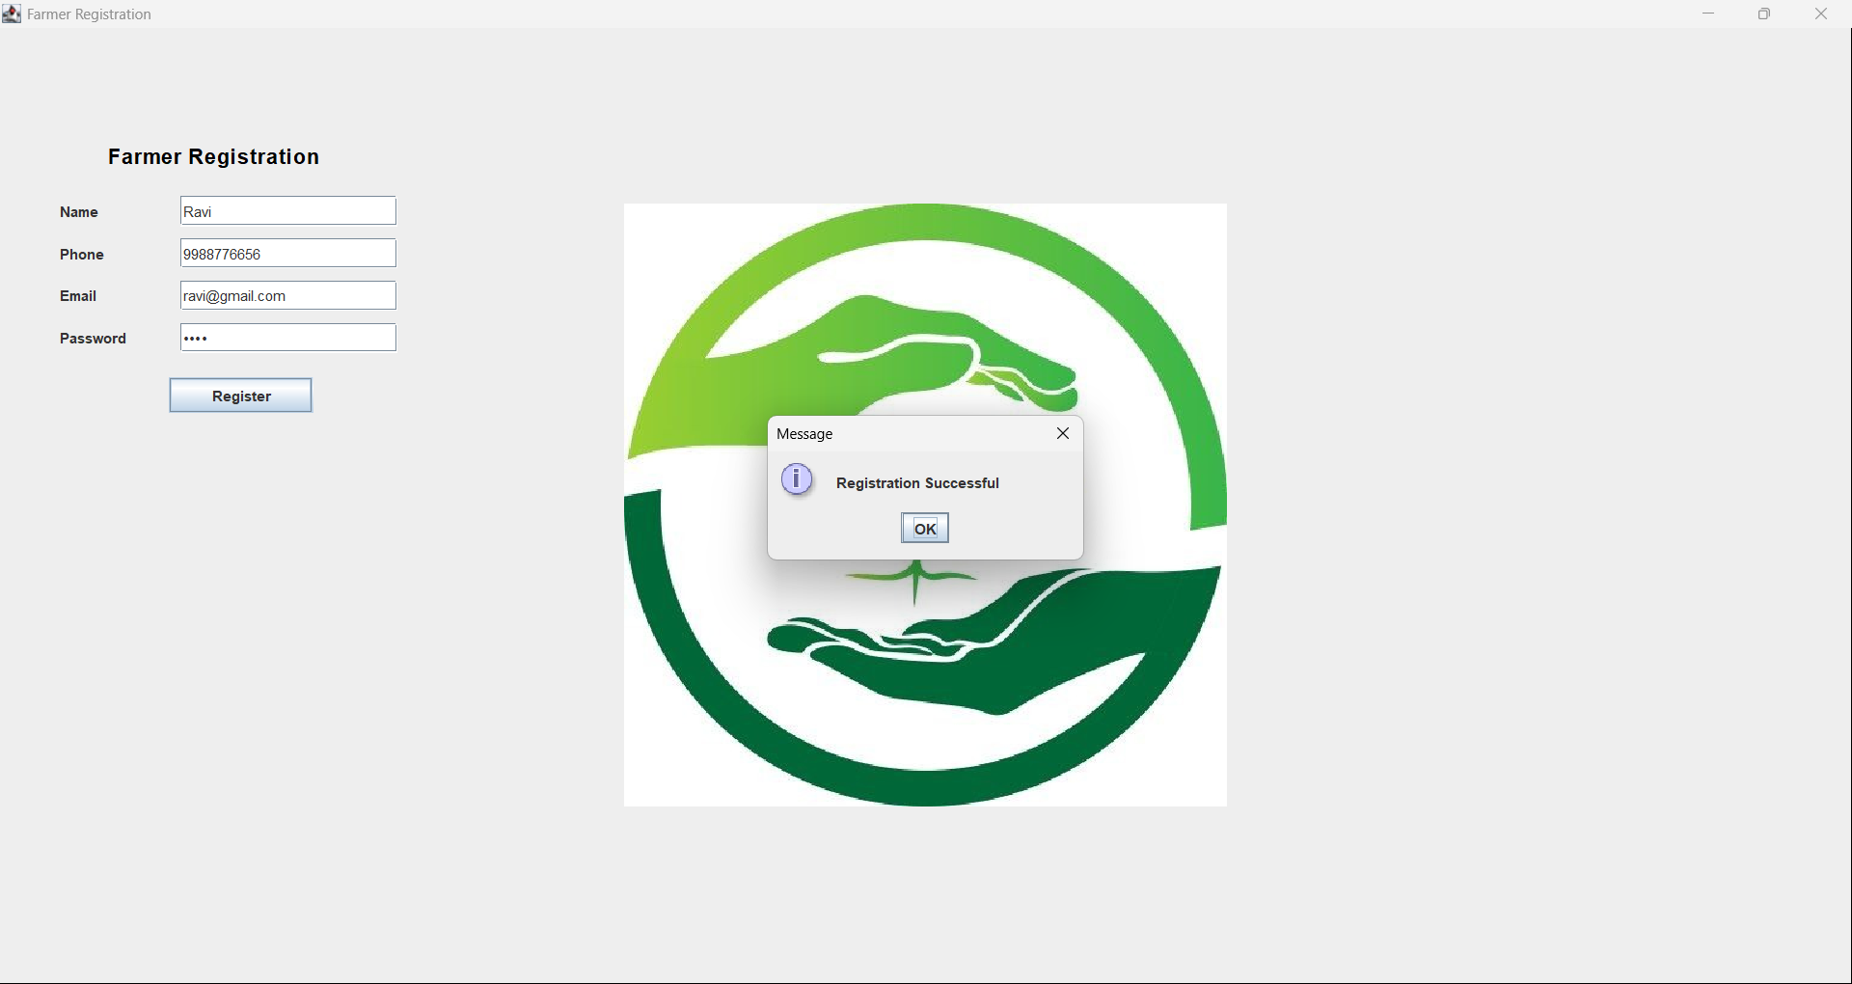
OUTPUT

Slide 10
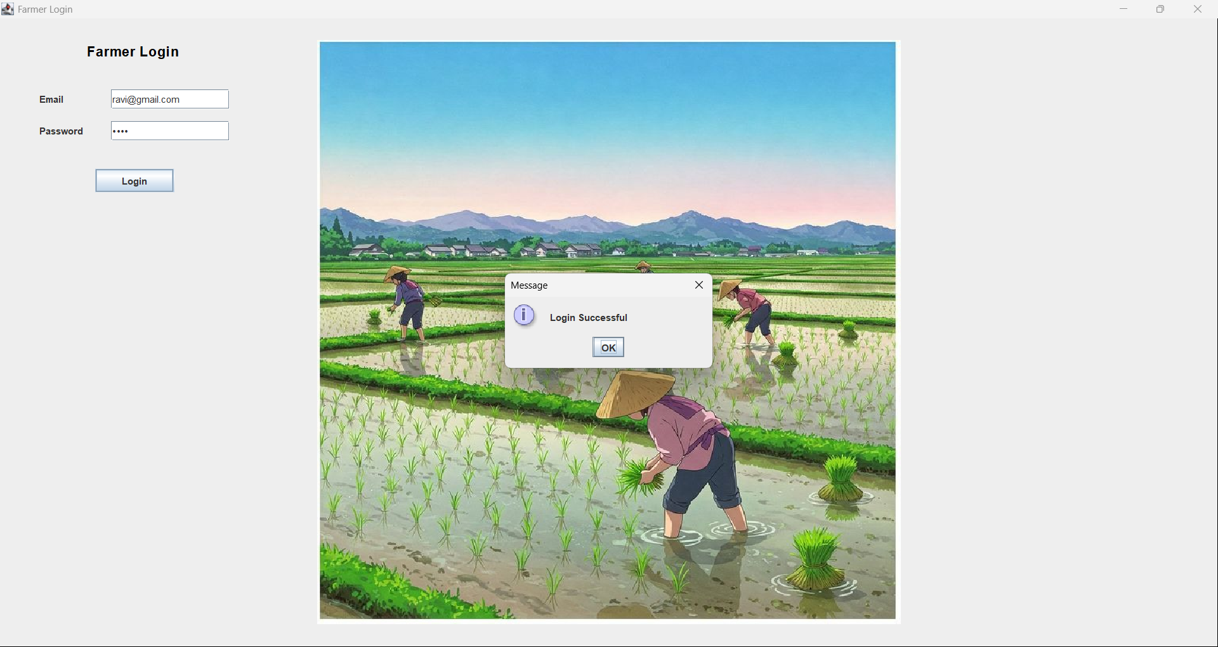
OUTPUT

Slide 11
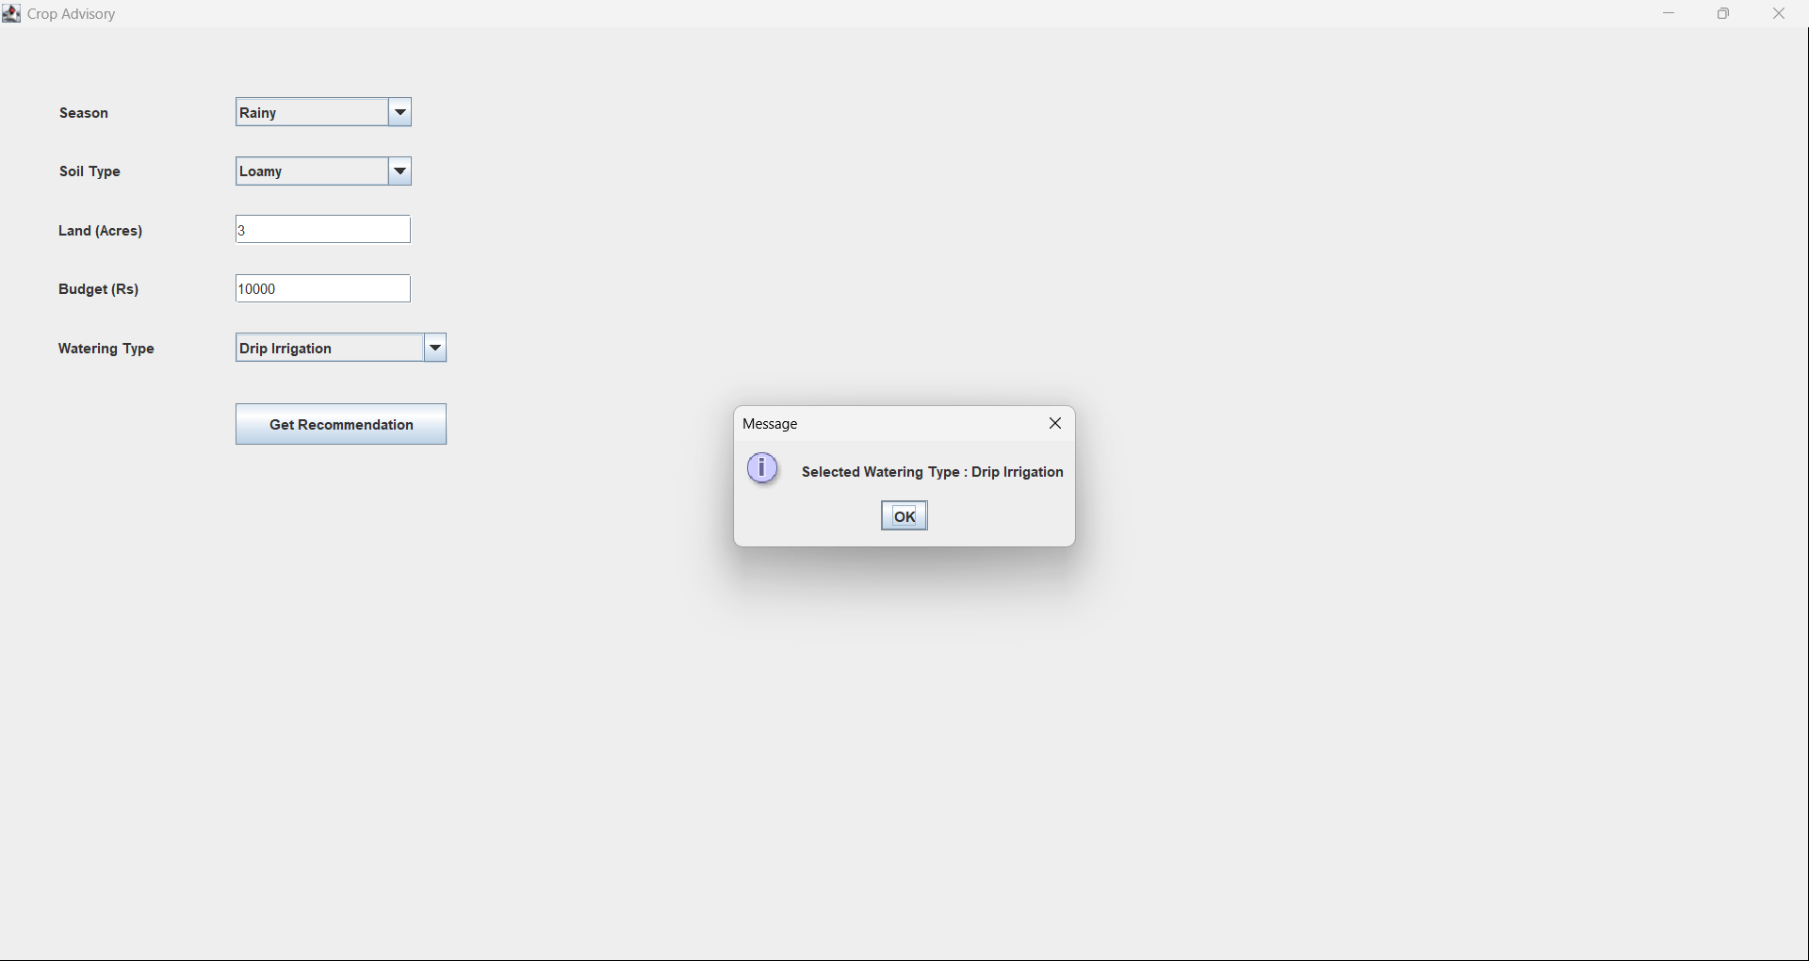
OUTPUT

Slide 12
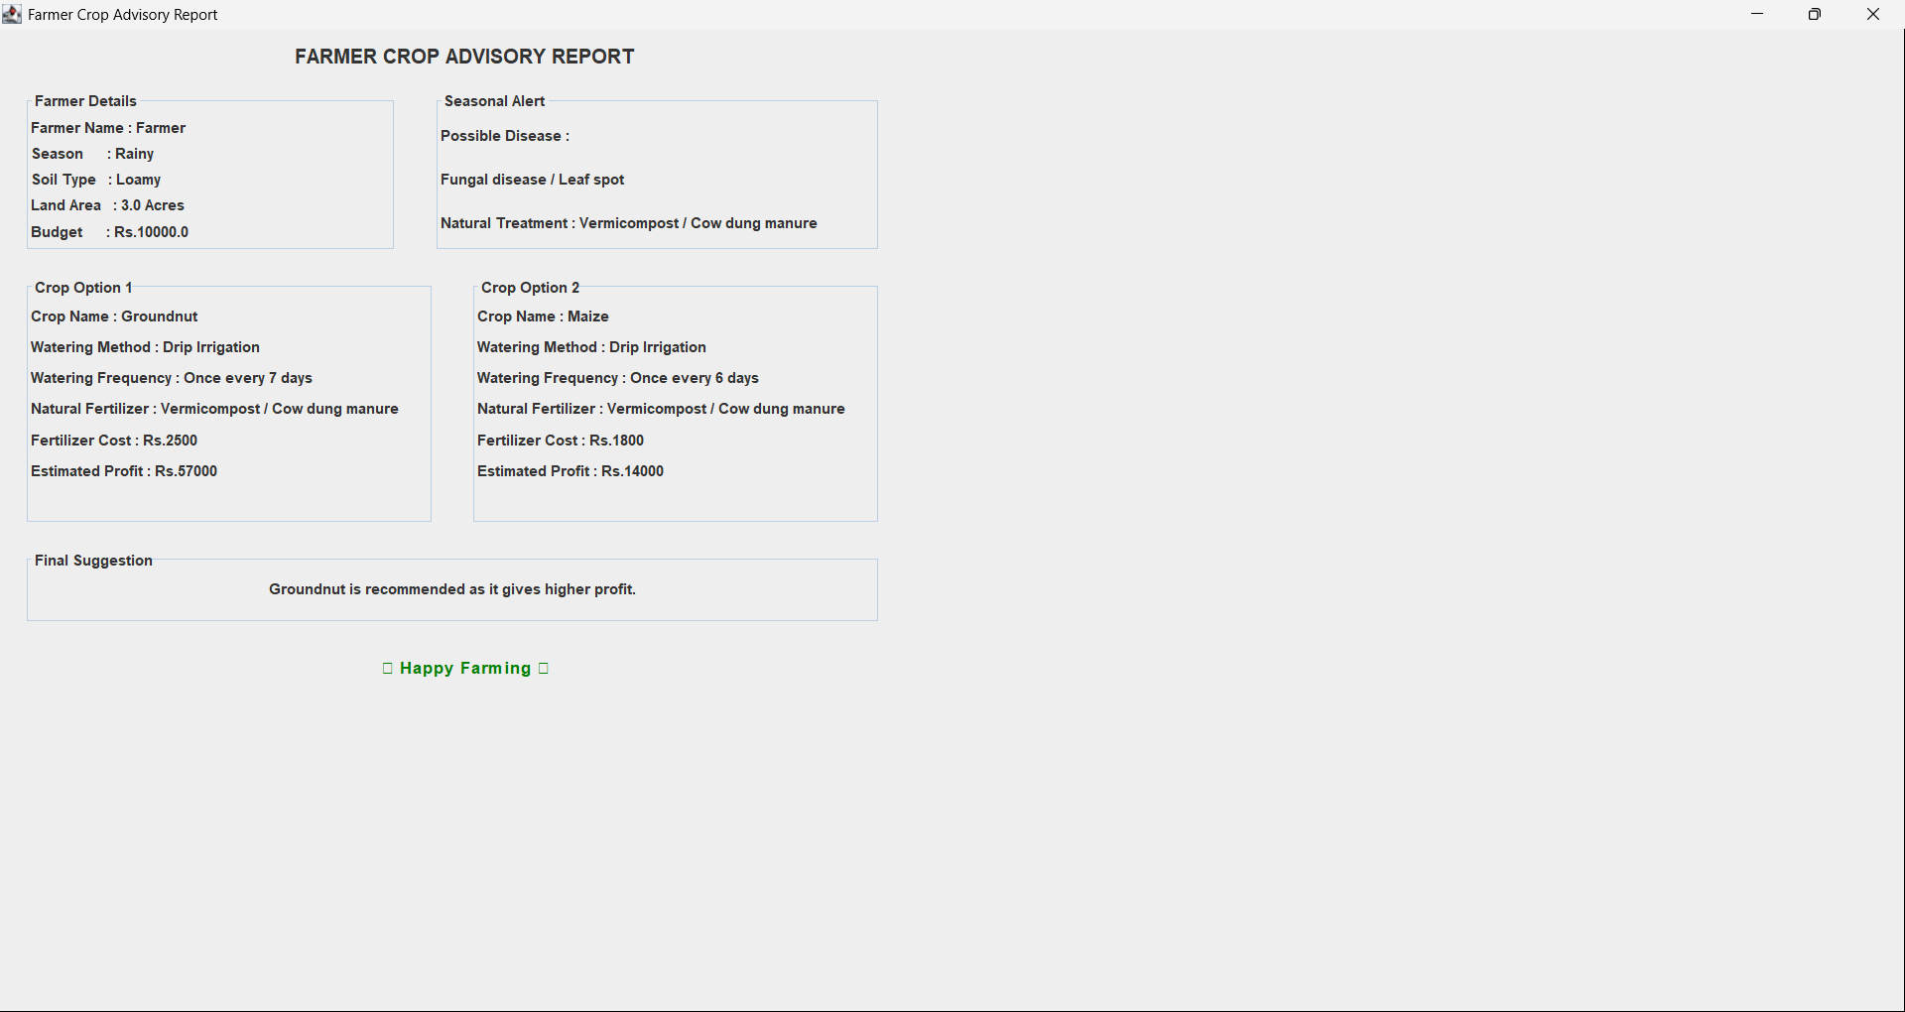
OUTPUT

Slide 13
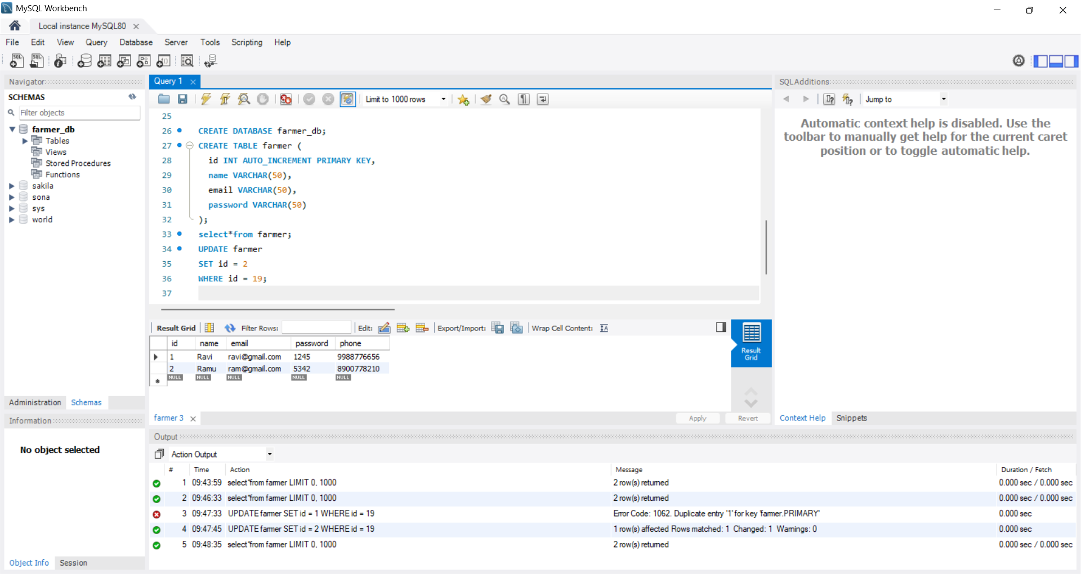
MySQL

Slide 14


